Slide 1

CST 499 Final Software Project
Ben Merritt
CST 499: Capstone for computer software technology
Dr. Charmelia Butler
12/11/2023

Slide 2
Introduction
Objective: Today, we present our Course Enrollment System, designed to simplify and enhance the class registration experience for students, administrators, and teachers.
Key Focus Areas: Our system emphasizes user-centric efficiency, comprehensive features, robust database architecture, quality assurance through testing, and scalability.
Unified Platform: Bringing together a user-friendly interface, innovative features, and a meticulous technical foundation, our Course Enrollment System revolutionizes academic enrollment processes.
Notes:
I hope this journey through the Scrum Framework has shed light on its benefits and distinct characteristics in modern project management. We explored the key elements, roles, responsibilities, events, and artifacts to understand this dynamic methodology that cultivates collaboration, adaptability, and iterative progress. We examined the benefits of using Scrum and how it differs from traditional methods, such as the Waterfall Model. Finally, we reviewed Scrum in action through a group-planned vacation case study and the best practices for adopting Scrum. By embracing Scrum Framework and its principles, organizations can overcome the complexities of modern project management. It creates a culture of continuous improvement and customer-centricity that will lead to project excellence and customer satisfaction!

Slide 3
SRS Document
Main goal: Simple system that students register for classes
Objective: New users register with a unique ID and password, ensuring ID exclusivity. Profiles require essential information. Login uses ID and password. Courses run in three semesters; students list courses, each with a varying enrollment limit. Full courses allow waitlisting; cancellations notify waitlisted students for enrollment.
SRS document covers product perspective, functions, user classes, characteristics, operating environment, constraints, user documentation, and assumptions/dependencies.
External Requirements: User, Hardware, Software, Communication Interfaces.
Notes:
In this case study, our team of five coworkers used Scrum to plan the vacation to Hawaii. We decided to use Scrum because we wanted to have a flexible and collaborative approach that would allow us to adjust to changing requirements and feedback.
The first step was to define the product vision and the product backlog. The product vision was a statement that described the desired outcome of the vacation: "To have a memorable and enjoyable vacation in Hawaii that meets everyone's needs and expectations". The product backlog was a list of ten features and tasks that would contribute to the product vision, such as booking flights and hotels, researching attractions and activities, creating a budget, packing, etc. The product owner prioritized the backlog items based on their value and urgency.

Slide 4
SRS Document continued
The Course Enrollment System features: an Initial Home Page, a Sample Course Showcase for users, New User Registration and Profile Creation, User Login, User Home Page, Announcements and Notifications, Course Enrollment, Cancellation, Waiting List, User Logout, and Session Timeout.
Non-functional Requirements: Performance Requirements, Safety Requirements, Security Requirements, Software Quality Attributes, and Business Rules
The platform enables administrators to manage course and profile information, user feedback mechanism, prioritizing an intuitive interface with a maximum of 5 registration steps, reliability, high uptime and quick recovery, Scalability, Accessibility adheres to WCAG guidelines, compatibility with major browsers and devices. Regular backups, disaster recovery, seamless integration, SEO optimization, and responsive customer support.
Notes:
In this case study, our team of five coworkers used Scrum to plan the vacation to Hawaii. We decided to use Scrum because we wanted to have a flexible and collaborative approach that would allow us to adjust to changing requirements and feedback.
The first step was to define the product vision and the product backlog. The product vision was a statement that described the desired outcome of the vacation: "To have a memorable and enjoyable vacation in Hawaii that meets everyone's needs and expectations". The product backlog was a list of ten features and tasks that would contribute to the product vision, such as booking flights and hotels, researching attractions and activities, creating a budget, packing, etc. The product owner prioritized the backlog items based on their value and urgency.

Slide 5
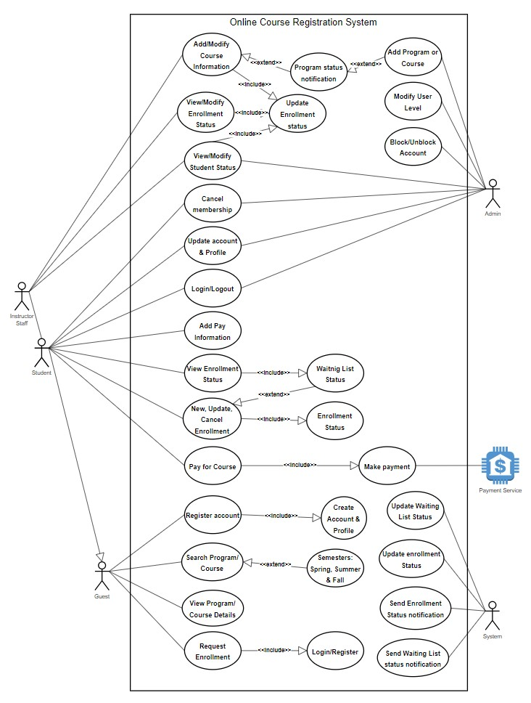
UML Model
USE CASE DIAGRAM

Slide 6
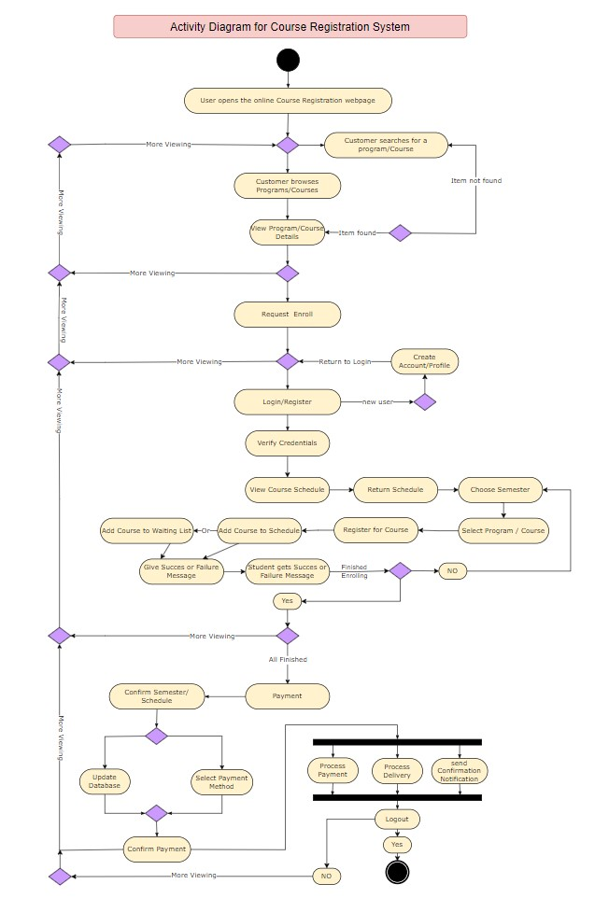
UML Model
ACTIVITY DIAGRAM

Slide 7
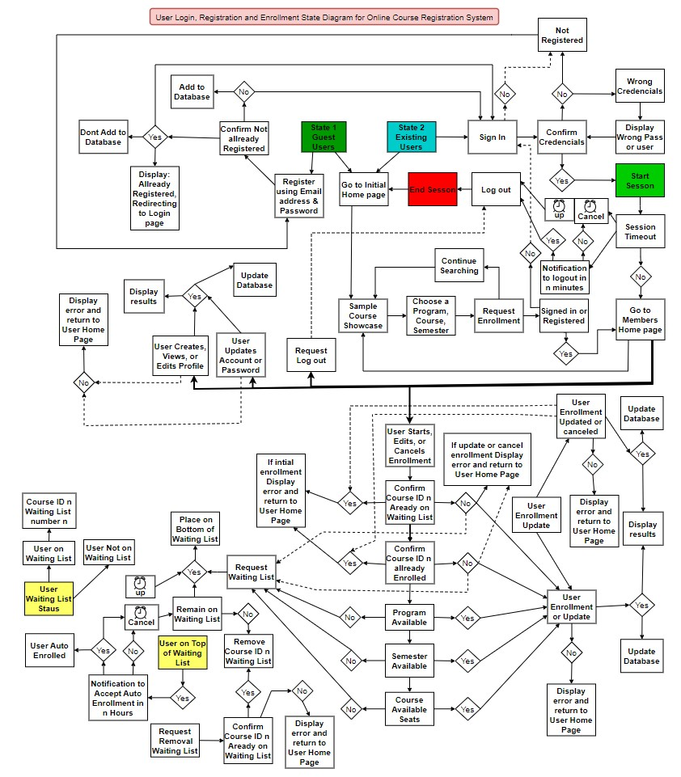
UML Model
STATE DIAGRAM

Slide 8
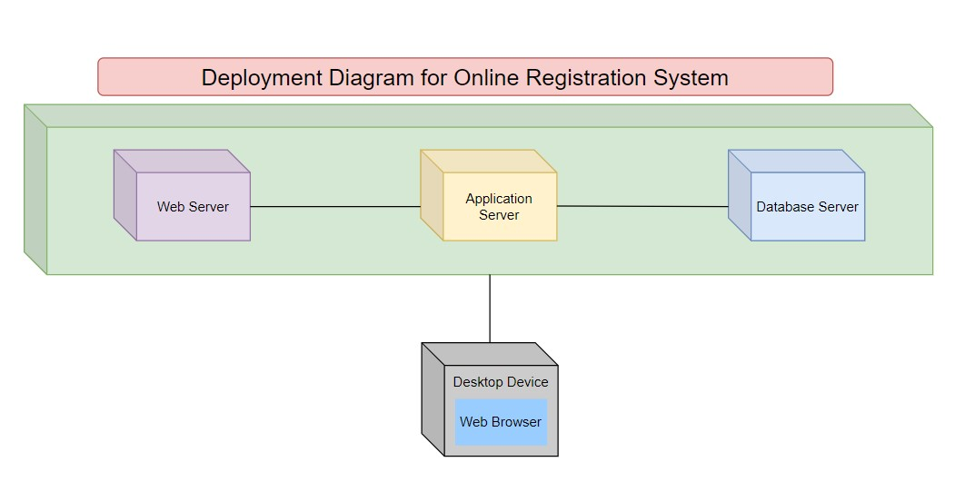
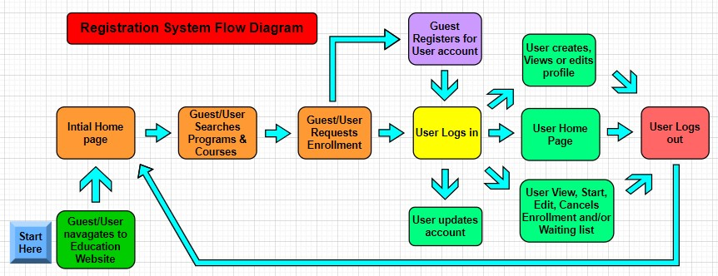
UML Model
DEPLOYMENT & FLOW DIAGRAMS

Slide 9
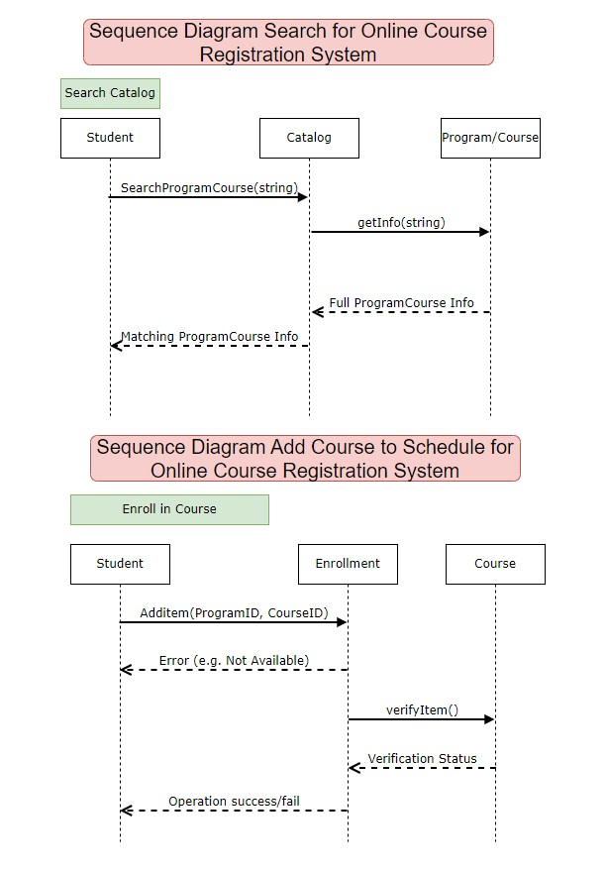
UML Model
SEQUENCE DIAGRAMS

Slide 10
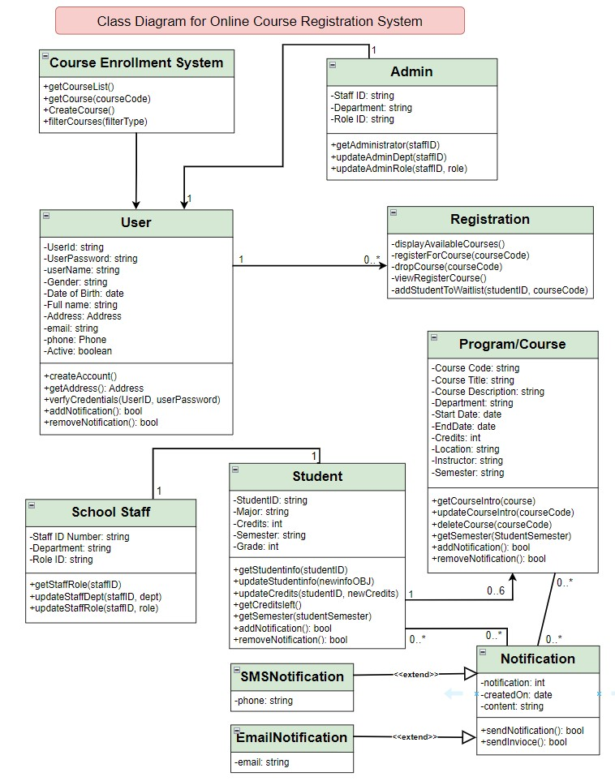
UML Model
CLASS DIAGRAM

Slide 11
Software Testing
Testing plays a crucial role in software development, reducing cost and time efficiency and enhancing maintainability and code quality. The Course Enrollment System will undergo various testing phases, including Integration testing, Component testing, System testing, and Acceptance testing. Integration testing assesses modules, components, and units collectively, while Component testing evaluates components independently. System testing examines the entire system with integrated components. Acceptance testing ensures the system aligns with requirements before delivery to the customer, focusing on quality assurance (Tsui, 2018; Spiller et al., 2014).
Notes:
The Scrum Master is the specific individual responsible for ensuring that Scrum values, practices and rules are enacted and enforced. They coach the team, the product owner, and the business on the scrum process and look for ways to fine-tune their practice of it. The Scum Master is sometimes characterized as the project manager who leads by coaching, teaching and supporting the Team rather than directing and controlling. A Scrum Master is not a project manager. Project managers don't really have a place in the scrum methodology. The project manager role within Scrum ceases to exist as its responsibilities are moved to the other Scrum roles.
Product owners are not managing the status of the program. A product owner is not a project manager. They ensure that the development team delivers the most value to the business. Also, it's important that the product owner be an individual. The role of the Product Owner is the most complex one regarding the procedure being followed. Product owners are the champions for their product. They are focus on understanding the business and market requirements, then prioritizing the work to be done by the engineering team accordingly.
Scrum teams are the champions for sustainable development practices. The most effective scrum teams are tight-knit, co-located, and is typically seven people, plus or minus two. Teams are cross functional, having all the skills needed to create an increment i.e. team members have differing skill sets, and cross-train each other so no one person becomes a bottleneck in the delivery of work. Strong scrum teams approach their project with a clear "we" attitude. All members of the team help one another to ensure a successful sprint completion.

Slide 12
Landing, Login, Enrollment Pages
Landing or Initial Home Page: Top jumbotron class dark blue background with light green main school title lettering and Navigation bar light green with blue lettering tabs. Colors are easy to read and contrast well with each other. Simple Welcome and instructions to log in to enroll with links to login and registration pages.
Login Page: The login page is a simple username and password input boxes with a Submit button. Verification is checked against the database for credentials.
Registration Page: Users not registered will be required to create a username, password, first and last name, and then the save button. The user is added to the users table in the database and may Log in as a new applicant role. Administrator upgrades role to student to allow access to enrollment pages.
Notes:
Scrum is designed to be flexible and adaptable to changing requirements and priorities. It allows teams to regularly reassess and reprioritize tasks based on feedback and emerging needs, enabling quicker responses to market demands. Scrum emphasizes delivering working increments of the product at the end of each sprint. This frequent delivery of tangible results ensures that customer feedback is regularly incorporated into the product, increasing customer satisfaction. While Scrum offers numerous benefits, it is essential to remember that the successful implementation of Scrum requires commitment, adherence to its principles, and continuous learning and improvement by the team and the organization.

Slide 13
Class Registration
Course catalog/classes Pages: Lists all courses taught at the school. A “See classes” button link sends students to classes if available for course and includes a “See all” to goto all classes being offered by semester includes a “Enroll in this class” or “Jion Waiting list” button to enroll or be put on waiting list if class seats is zero.
My schedule Page: Shows semester, teacher, class information and includes a button “Withdraw from this class” which would open up a seat for a student on a waiting list, auto-enroll them in the course with a message sent to “My Notifications” letting the student know they were enrolled. The message can be marked as read.
Roles: Applicants can log in have to wait to have access and can Use Contact Us page to send message to database. Administrators upgrade roles to student or teacher to allow access to pages.
Notes:
Scrum is designed to be flexible and adaptable to changing requirements and priorities. It allows teams to regularly reassess and reprioritize tasks based on feedback and emerging needs, enabling quicker responses to market demands. Scrum emphasizes delivering working increments of the product at the end of each sprint. This frequent delivery of tangible results ensures that customer feedback is regularly incorporated into the product, increasing customer satisfaction. While Scrum offers numerous benefits, it is essential to remember that the successful implementation of Scrum requires commitment, adherence to its principles, and continuous learning and improvement by the team and the organization.

Slide 14
MySQL Database
Database cst499_ben: The initial database, tables, courses, classes, students, teachers, and administrator information is Imported by an SQL file into phpMyAdmin.
Tables:
”users” Stores Registration/log in credentials for all users and role status.
“students” Stores user/role information of undergrad and graduate students.
“teachers” Stores user/role information of instructors and professors.
“administrators” Stores user/role information of administrators.
“roles” Stores Roles 1-10 and role names.
“semesters” Stores semester & start and end dates.
“subject_tracks” & “rooms” Tracks by subject/ room.
“courses” & “offerings” Stores course and class information.
“enrollment” Tracks class, user, date, and enroll status: “a” enrolled, “w” withdrew, or “q” waiting list.
“messages” Tracks waiting list messages status “r” read or “u” unread.
“contact_messages” Stores email and messages sent with Contact Us page. Everyone may send only.
“messages_chat” Stores chats from and to users with date sent and date read. No access for new applicants.
Notes:
Scrum is designed to be flexible and adaptable to changing requirements and priorities. It allows teams to regularly reassess and reprioritize tasks based on feedback and emerging needs, enabling quicker responses to market demands. Scrum emphasizes delivering working increments of the product at the end of each sprint. This frequent delivery of tangible results ensures that customer feedback is regularly incorporated into the product, increasing customer satisfaction. While Scrum offers numerous benefits, it is essential to remember that the successful implementation of Scrum requires commitment, adherence to its principles, and continuous learning and improvement by the team and the organization.

Slide 15
PHP Code Explanation
The PHP code for the course enrollment system is organized into several files, each serving a specific purpose in managing various aspects of the system. The foundational files such as db.php, config.php, and connect.php handle database connections, configurations, and general functionality. The classes.php, classes_student.php, and classes_teacher.php files manage class-related operations, while courses.php, courses_student.php, and course_teacher.php handle course-related functionalities. The schedule.php, schedule_student.php, and schedule_teacher.php files are responsible for scheduling operations. The grades.php, grades_student.php, and grades_teacher.php files handle grading processes. The system's user management is distributed among session.php, student.php, teacher.php, administrator.php, roles.php, profile.php, profile_student.php, profile_teacher.php, and profile_administrator.php. The adminpan.php file controls the administrative panel, and chatbox.php, chatbox_app.php, and messages.php manage communication features. Registration and login functionalities are implemented in registration.php and login.php, respectively. The master.php file serves as the template for consistent page structure, while footer.php provides the footer section. The system's main interface is defined in index.php. This modular approach ensures clarity, maintainability, and scalability in the course enrollment system's PHP codebase (Lan & Li 2022).
Notes:
Scrum is designed to be flexible and adaptable to changing requirements and priorities. It allows teams to regularly reassess and reprioritize tasks based on feedback and emerging needs, enabling quicker responses to market demands. Scrum emphasizes delivering working increments of the product at the end of each sprint. This frequent delivery of tangible results ensures that customer feedback is regularly incorporated into the product, increasing customer satisfaction. While Scrum offers numerous benefits, it is essential to remember that the successful implementation of Scrum requires commitment, adherence to its principles, and continuous learning and improvement by the team and the organization.

Slide 16
Conclusion
User-Focused Efficiency: Simplifying class registration, our system ensures a seamless experience with unique IDs, intuitive profiles, and a user-friendly, 5-step enrollment process.
Comprehensive Features: The Course Enrollment System boasts an array of functionalities, from an Initial Home Page to Waiting List Management, catering to administrators, students, and teachers.
Robust Database and Codebase: A well-structured database, coupled with a modular PHP code organization, guarantees clarity, maintainability, and scalability for efficient data management.
Quality Assurance Through Testing: Rigorous testing, including Integration, Component, System, and Acceptance testing, underscores the system's reliability, maintainability, and code quality.
Reliable and Scalable Solution: With a user-centric design, robust technical foundation, and meticulous testing, the Course Enrollment System emerges as a reliable and scalable solution for academic institutions.
Notes:
I hope this journey through the Scrum Framework has shed light on its benefits and distinct characteristics in modern project management. We explored the key elements, roles, responsibilities, events, and artifacts to understand this dynamic methodology that cultivates collaboration, adaptability, and iterative progress. We examined the benefits of using Scrum and how it differs from traditional methods, such as the Waterfall Model. Finally, we reviewed Scrum in action through a group-planned vacation case study and the best practices for adopting Scrum. By embracing Scrum Framework and its principles, organizations can overcome the complexities of modern project management. It creates a culture of continuous improvement and customer-centricity that will lead to project excellence and customer satisfaction!

Slide 17
References
Ada-compliance (2010, September 15). 2010 ADA Standards ADA Regulations for Accessible Design. Ada-Compliance.com. Retrieved from https://www.ada-compliance.com/ada-compliance/2010-ada-standards
Chikh, A., & Alajmi, H. (2014, January 17–19). Towards a dynamic software requirements specification. [Paper presentation]. 2014 World Congress on Computer Applications and Information Systems (WCCAIS), Hammamet, Tunisia. https://doi.org/10.1109/WCCAIS.2014.6916656
Lan, T., & Li, M. (2022). Design of college digital enrollment System based on big data platform in digital communication era. 2022 6th International Conference on Wireless Communications and Applications (ICWCAPP), Wireless Communications and Applications (ICWCAPP), 2022 6th International Conference on, ICWCAPP, 196–200. https://doi.org/10.1109/ICWCAPP57292.2022.00055

Slide 18
References Continued
Spillner, A., Linz, T., & Schaefer, H. (2014). Software testing foundations: A study guide for the certified tester exam (4th ed.). Rocky Nook.
Tsui, F., Karam, O., & Bernal, B. (2018). Essentials of software engineering (4th ed.). Jones & Bartlett Learning.
Wiegers, K. E. (1999). Software requirement specifications for <project>. [Template]. https://web.cs.dal.ca/~hawkey/3130/srs_template-ieee.doc

